Slide 1
NAME -> Tarang Srivastava Institution ->IIT BHU

Slide 2
FINLATICS
DATA SCIENCE CASE BASED PROJECT
ANALYSIS OF BANKING DATA SET
MARKRTING CAMPAIGN RUN BY A PORTUGESE BANK TO SELL TERM DEPOSITS TO ITS PROSPECTIVE CUSTOMERS

Slide 3
Introduction and Dataset Overview: In this project, we analyzed a financial data set, which improved our data science proficiency and provided us with a clear understanding of data science. Goal: To examine the variables affecting the probability of signing up for a term deposit. The dataset is described as follows: it consists of 18 columns and 45,211 rows arranged chronologically (May 2008 to November 2010).It included other columns, such as ->age, marital, pdays, etc.

Slide 4
EDA (exploratory data analysis): The dataset includes information from a term deposit marketing campaign run by a Portuguese bank. The important characteristics include socioeconomic background, contact information, campaign specifics, and demographic data. For a better understanding of the distribution of age, employment, marital status, education level, average yearly balance, Days since the client was last contacted from a previous campaign, last contact day and month, duration of the last contact, and clients who subscribed to a term deposit against those who did not are all considered .We have used the seaborn and matplotlib packages to create a bar graph and histogram. This helps us in providing a colorful description of range , maximum , minimum data and many more.

Slide 5
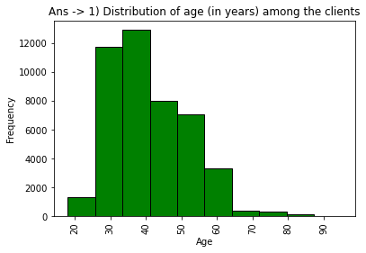
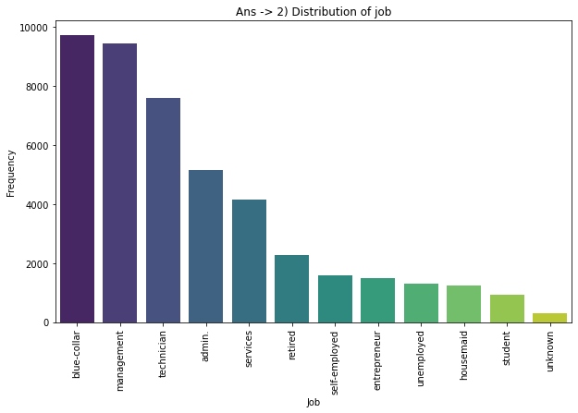
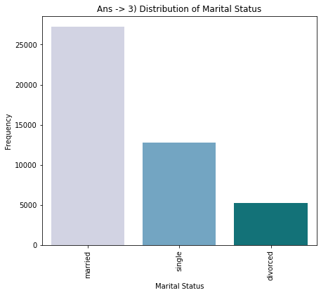
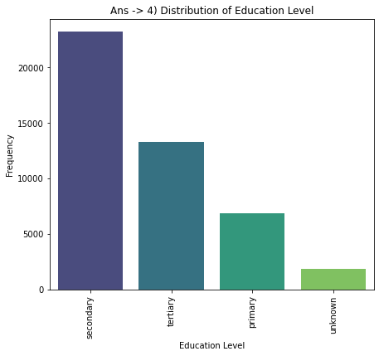
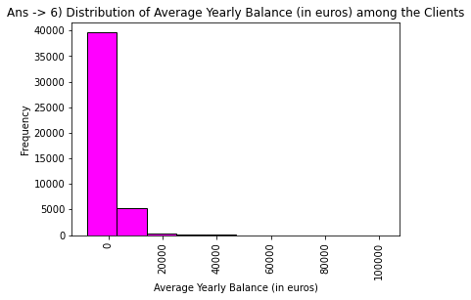
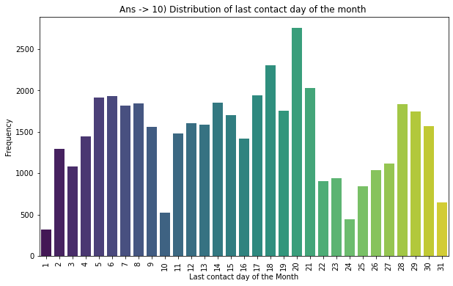
Visualizations such as the distribution of the target variable, histograms, or bar->

Slide 6
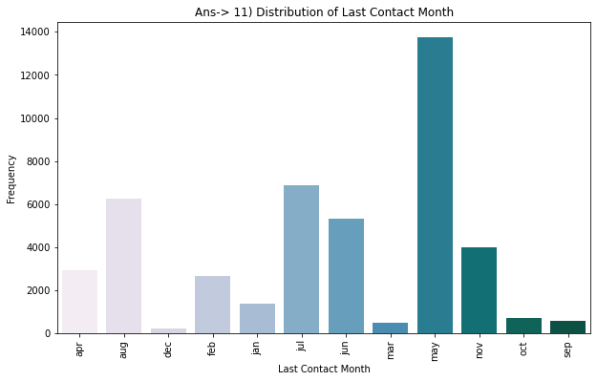
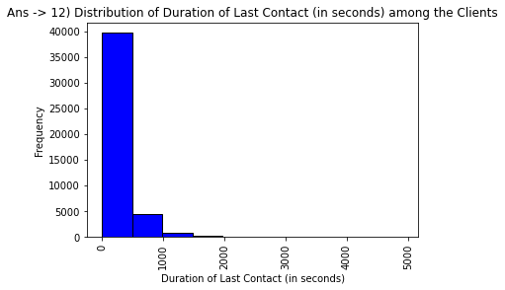
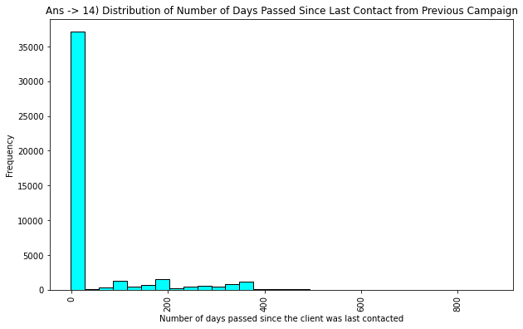
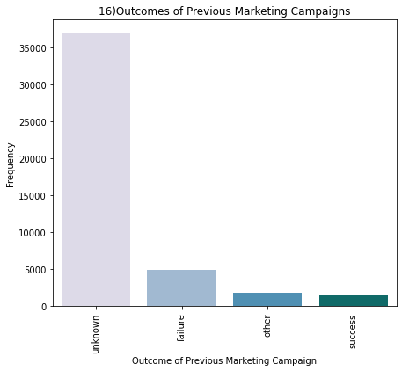
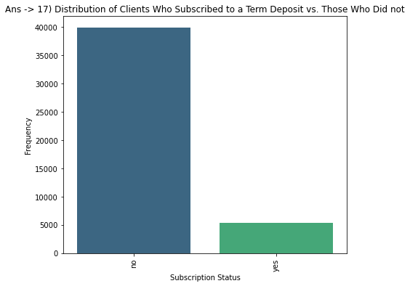

Slide 7
The brief overview of Ans ->1 , 2 , 3 , 4 , 6 , 10 , 11 , 12 , 14 , 17) plt.hist-> this function helps to create a histogram. sns.barplot-> this function helps to create a bar graph. plt.xlabel(“title for x axis”) . plt.ylabel(“title for y axis”). plt.title(“title for your barplot/histogram”). plt.xticks(rotation=90). plt.show()->helps to display the barplot , histogram. title_distribution = df[‘title’].value_counts().reset_index()->this calculates the no. of occurences of each unique value in the title column and reset index ->resets the index of resulting series , turning it into a data frame. title_distribution.columns = [‘title’,’count’]->this give the column names of dataframe. title_distribution = title_distribution.sort_values(by=‘title').reset_index(drop=true)->this sorts the dataframe by title column in ascending order and reset the index of the sorted dataframe and drops the old index # calculate total missing 'title’ -> data missing_title_count = df['title'].isnull().sum() # calculate mode (most frequent value) for 'title’ -> mode_title = df['title'].mode()[0] # if 'title' was numeric, you would calculate these: # note: the following calculations only make sense if 'title' is numeric # std_dev_title = df['title'].std() # range_title = df['title'].max() - df['title'].min() # median_title = df['title'].median()

Slide 8
Ans 5)-> Proportion of clients who have credit in default total_default_yes = default_counts.get('yes', 0)#defaults to 0 ->calculate total no. of yes in default column and then calculate(total no. of yes)/total enteries

Slide 9
Ans 7) , 8)No. of clients having housing loans , personal loan-> total_housing_loan_yes = title_loan_counts.get('yes', 0) # defaults to 0 -> total no. of clients who have housing/personal loan

Slide 10
9)The communication types used for contacting clients during the campaign communication_types = df['contact'].unique() -> this give an insight of different type of communication used

Slide 11
Ans 13 , 15) Display the number of contacts for each client , number of contacts performed before the current campaign for each client-> print(df[[‘column name’]]) ->this prints the whole data of the column

Slide 12
Ans 17) This questions ask for correlations between different attributes and the likelihood of subscribing to a term deposit For this we need to create a correlation matrix which gives us an insight of the required correlation-> Correlation acts like a measuring stick for the intensity relationship between different attributes. The correlation coefficient is often denoted as "r“. If r = 1, it indicates a perfect positive linear relationship, meaning that as one variable increases, the other variable also increases proportionally. if r = −1, it indicates a perfect negative linear relationship, meaning that as one variable increases, the other variable decreases proportionally. if r = 0, it indicates no linear relationship between the variables
Size of correlation(r) | Interpretation
0.90 to 1.00 (-0.90 to -1.00) | Very high positive(negative) correlation
0.70 to 0.90 (-0.70 to -0.90) | High positive(negative) correlation
0.50 to 0.70 (-0.50 to -0.70) | Moderate positive(negative) correlation
0.30 to 0.50 (-0.30 to -0.50) | Low positive(negative) correlation
0 to 0.30 (0 to -0.30) | Negligible correlation

Slide 13
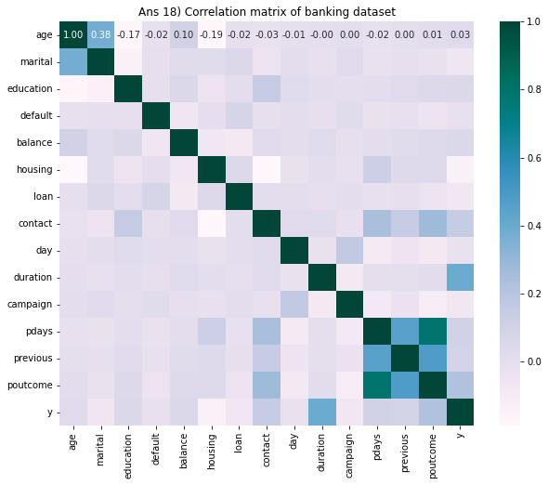
We could infer this->

Slide 14
Summary-> Client Demographics:
The dataset covers clients' age, job types, marital status, and education levels. Age ranges across various groups, with jobs spanning categories like administration, management, and others. Marital status shows diversity among clients, and education levels vary from primary to tertiary.
Financial and Credit Information:
Some clients have credit in default, impacting their financial standing. Average yearly balances vary significantly, suggesting a diverse financial profile among clients. A proportion of clients also have housing and personal loans, reflecting their financial commitments.
Communication and Campaign Details:
Communication channels used include telephone and cellular, highlighting the campaign's outreach strategies. Contacts are distributed across different days and months, indicating varied campaign timing and scheduling. The duration of contacts varies, potentially influencing campaign effectiveness.
Previous Campaign Performance:
Insights into previous campaigns reveal varying outcomes such as success, failure, or other results. The number of days since the last contact from previous campaigns and the number of previous contacts are also diverse, indicating different levels of client engagement history.
Term Deposit Subscription:
A binary outcome shows whether clients subscribed to a term deposit. The distribution indicates varying levels of interest and engagement with the term deposit offering.

Slide 15
Thank you

